Slide 1
Employee Data Analysis using Excel
STUDENT NAME: RAGAVI. M
REGISTER NO:312200477
DEPARTMENT:B.com(computer application)
COLLEGE:S.I.V.E.T college Gowrivakkam, chennai

Slide 2
PROJECT TITLE
employees attrition analysis using excel dashboard

Slide 3


AGENDA
Problem Statement
Project Overview
End Users
Our Solution and Proposition
Dataset Description
Modelling Approach
Results and Discussion
Conclusion
3/21/2024 Annual Review

Slide 4

PROBLEM STATEMENT
*Problem Statement:*“
Our organization is experiencing high employee turnover rates, resulting in increased recruitment costs, decreased productivity, and potential losses in intellectual capital. To better understand and address this issue, we need to analyze the trends, patterns, and factors contributing to employee attrition.

Slide 5

PROJECT OVERVIEW
.objective:
Analyze employee attrition trends and patters to identify key factors contributing to turnover.
Scope:
Implement predictive analytics to forecast future turnover.
Deliverables:
Employee attrition analysis report.
Resources :
HR data and support
Excel software and expertise.
Benefits :
Data- driven insights into employee attrition trends and factors.

Slide 6

Who is the end user?
Here are some potential end-users for an Employee Attrition Analysis using an Excel Dashboard:
HR Managers: To inform recruitment, retention, and talent management strategies.
Talent Acquisition Team: To identify trends and patterns in turnover, improving hiring processes.
Organizational Development Team: To develop targeted initiatives enhancing employee engagement and retention.4.
Business Leaders: To understand the impact of attrition on business performance and make data-driven decisions.
Department Managers: To identify and address specific issues driving turnover within their teams.
T
Notes:
Ghhhb

Slide 7

OUR SOLUTION AND ITS VALUE PROPOSITION
Here are some potential solutions and value propositions for an Employee Attrition Analysis using an Excel Dashboard:
Solution 1:* Predictive Attrition Modeling_Value Proposition:_ Identify high-risk employees and departments, enabling proactive retention strategies and reducing turnover costs.
Solution 2:* Interactive Attrition Dashboard_Value Proposition:_ Explore attrition trends, patterns, and drivers in real-time, facilitating data-driven decision-making and informed retention initiatives.
Solution 3:* personalized Retention Recommendations_Value Proposition:_ Receive tailored suggestions for improving employee retention, based on unique attrition profiles and organizational goals.

Slide 8
Dataset Description
Here's a potential dataset description for an Employee Attrition Analysis using an Excel Dashboard:
Dataset Name:* Employee Attrition Analysis Dataset
Description:* This dataset contains HR-related data for analyzing employee attrition trends, patterns, and drivers.
Data Sources:*- HR Information System (HRIS)- Employee Exit Surveys- Performance Management System- Payroll System.

Slide 9

THE "WOW" IN OUR SOLUTION
Factor 1:_- Predictive Analytics: Implement machine learning algorithms to forecast future turnover, enabling proactive retention strategies._
Factor 2:_- Interactive Visualizations: Create dynamic, drill-down dashboards allowing users to explore attrition trends, patterns, and drivers in real-time._
Factor 3:_- Personalized Insights: Provide tailored recommendations for each department, manager, or employee group, based on their unique attrition profile._
Wow Factor 4:_- Real-time Monitoring: Update the dashboard in real-time, enabling instant identification.
3/21/2024 Annual Review
9

Slide 10
MODELLING
Here's a potential approach to modeling employee attrition analysis using an Excel dashboard:*Step 1: Data Collection*- Gather relevant HR data (e.g., employee demographics, tenure, performance, exit surveys)- Import data into Excel*Step 2: Data Preparation*- Clean and preprocess data (e.g., handle missing values, data formatting)- Create data tables and pivot tables for analysis*Step 3: Attrition Rate Calculation*- Calculate overall attrition rate and department-specific rates- Use formulas to calculate raOUNTIF(status="left")/COUNTIF(status="active")`)
10

Slide 11
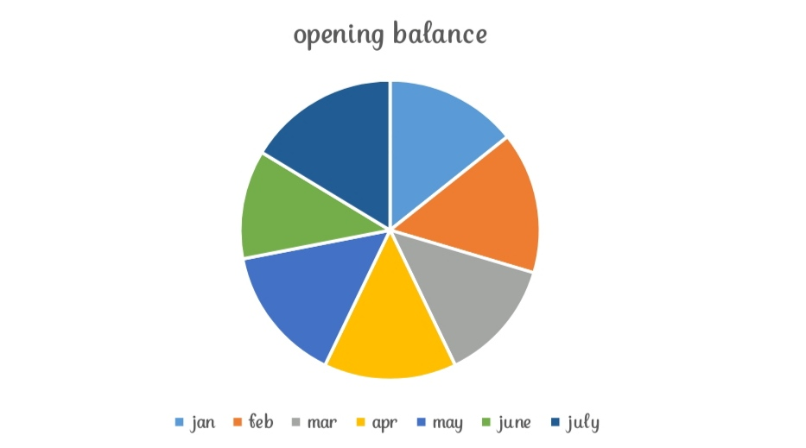
RESULTS
11

Slide 12
conclusion
Conclusion, the Employee Attrition Analysis Excel Dashboard provides a powerful tool for organizations to understand and address employee turnover.
By leveraging predictive analytics, interactive visualizations, and personalized insights, HR leaders and managers can:- Identify high-risk employees and departments- Uncover underlying drivers of attrition- Develop targeted retention strategies- Monitor progress and adjust approaches in real-timeThis solution enables data-driven decision-making, reducing the risk of costly turnover and enhancing organizational performance.

